Slide 1

Smart Water Management: Digital Scheduling and Reservoir Optimization System for Dharan

Slide 2
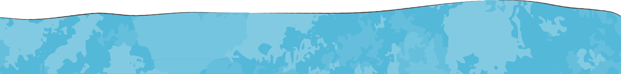
Arpan Shrestha Arun KC Rijan Rai

Slide 3
Introduction

Slide 4
Introduction
World, Urbanization, Dharan, Water Supply
Urban water supply has become one of the most pressing issue, driven by various factors such as increasing population, changing lifestyle, economic growth and development. The urban population in Nepal reached its highest share of 21.9% in 2023, showing a 2.33% increase compared to the previous year.
Dharan is situated on the foothills of the Mahabharat Range with mostly flat ground but includes some steep areas. The city relies on two main water sources: surface water and groundwater.
However, the demand for water is extremely high, leaving hundreds of households with irregular water supplies or forcing them to wait days for small amounts of water from their taps. The Dharan Water Supply Management Board oversees the city’s water distribution. Key factors contributing to water insecurity in Dharan sub-metropolitan include rapid population growth, climate change, limited water sources, steep terrain, over extraction, technical leaks, and political challenges.

Slide 5
Introduction
World, Urbanization, Dharan, Water Supply
In Dharan, water supply heavily relies on ground water as surface water may not be available all the time. Over the past decade, Dharan has been facing the water crisis, particularly during the dry seasons. In Dharan, the average water shortage months is 5.51 months. During the dry season, 49% water is less available compared to other months [3].To meet the growing demand for water, it is essential to optimize its distribution, ensuring that all households receive an adequate supply according to their needs. By improving water allocation, we can help ensure a more equitable and sustainable supply across the city.

Slide 6
Problem Statement

Slide 7
Problem Statement
Present Water, Supply & Demand, Authority
Dharan is home to thousands of people. Being one of the most populated cities in Nepal, the challenge of providing sufficient water to the public has been a major problem in Dharan, especially during the dry season. On average, 20 million liters per day (MLD) are collected from both sources during each season. However, limited water availability combined with high demand has led to a significant water supply crisis. The current demand is approximately 30 MLD, but only 20 MLD is supplied, leaving a substantial deficit. This shortfall can only be addressed through large-scale infrastructure projects, such as sourcing water from the Koshi or Tamor rivers. Despite various efforts by local authorities and the Nepal Water Supply Corporation to address the water shortage in Dharan, the city continues to struggle with ensuring fair and consistent water distribution. The Dharan Water Supply Management Board (DWSMB) currently lacks a digital system to monitor, predict, and manage water levels and distribution in real-time. With limited water resources, rapidly growing demand, and inadequate supply, households often experience irregular or insufficient water access.

Slide 8
Problem Statement
Present Water, Supply & Demand, Authority
30 MLD
Demand
20 MLD
Supply

Slide 9
Problem Statement
Water Sources
Table 1. Summary of surface source
Table 2. Summary of ground source
Surface Source | yield (MLD) | yield (MLD)
Surface Source | Wet Season | Dry season
Sardu Stream | 11.4 | 2.5
Khardu Stream | 6 | 2
Wells | No. of well | yield (MLD) | yield (MLD)
Wells | No. of well | Wet Season | Dry Season
NWSC | 3 | - | 6
Test Tube | 2 | - | 2
New Well | 5 | 2.72 | 7.2
Unofficial Source: Dharan Water Supply Management Board

Slide 10
Problem Statement
Causes of water insecurity in Dharan Sub-Metropolitan
Climate change Growing residence Limited source excess
Low ground water recharge
Over-abstraction Technical Leakage Management Politics
Lack of digital system to monitor, predict, and manage water levels and distribution in real-time

Slide 11
Problem Statement
Our solution
To meet the growing demand for water, it is essential to optimize its distribution, ensuring that all households receive an adequate supply according to their needs. By improving water allocation, we can help ensure a more equitable and sustainable supply across the city.
Software solution that can provide accurate, real-time insights into water levels and optimize the distribution of available water to meet the needs of all residents effectively.

Slide 12
Objectives

Slide 13
Objectives
The main objective of the system we have designed is to equally supply/distirbute the available water to all the areas or wards in the Dharan sub-Metropolitan city. The system provides a timely schedule, which lets the client or the public know when the water will be available in their area.
Besides it some of the objectives of our proposed sytem are mentioned below
To provide an admin dashboard with real-time insights into current reservoir water levels and enable accordingly.
To develop a mobile app that informs consumers about the water supply schedule.
To ensure equitable water distribution across all wards.

Slide 14
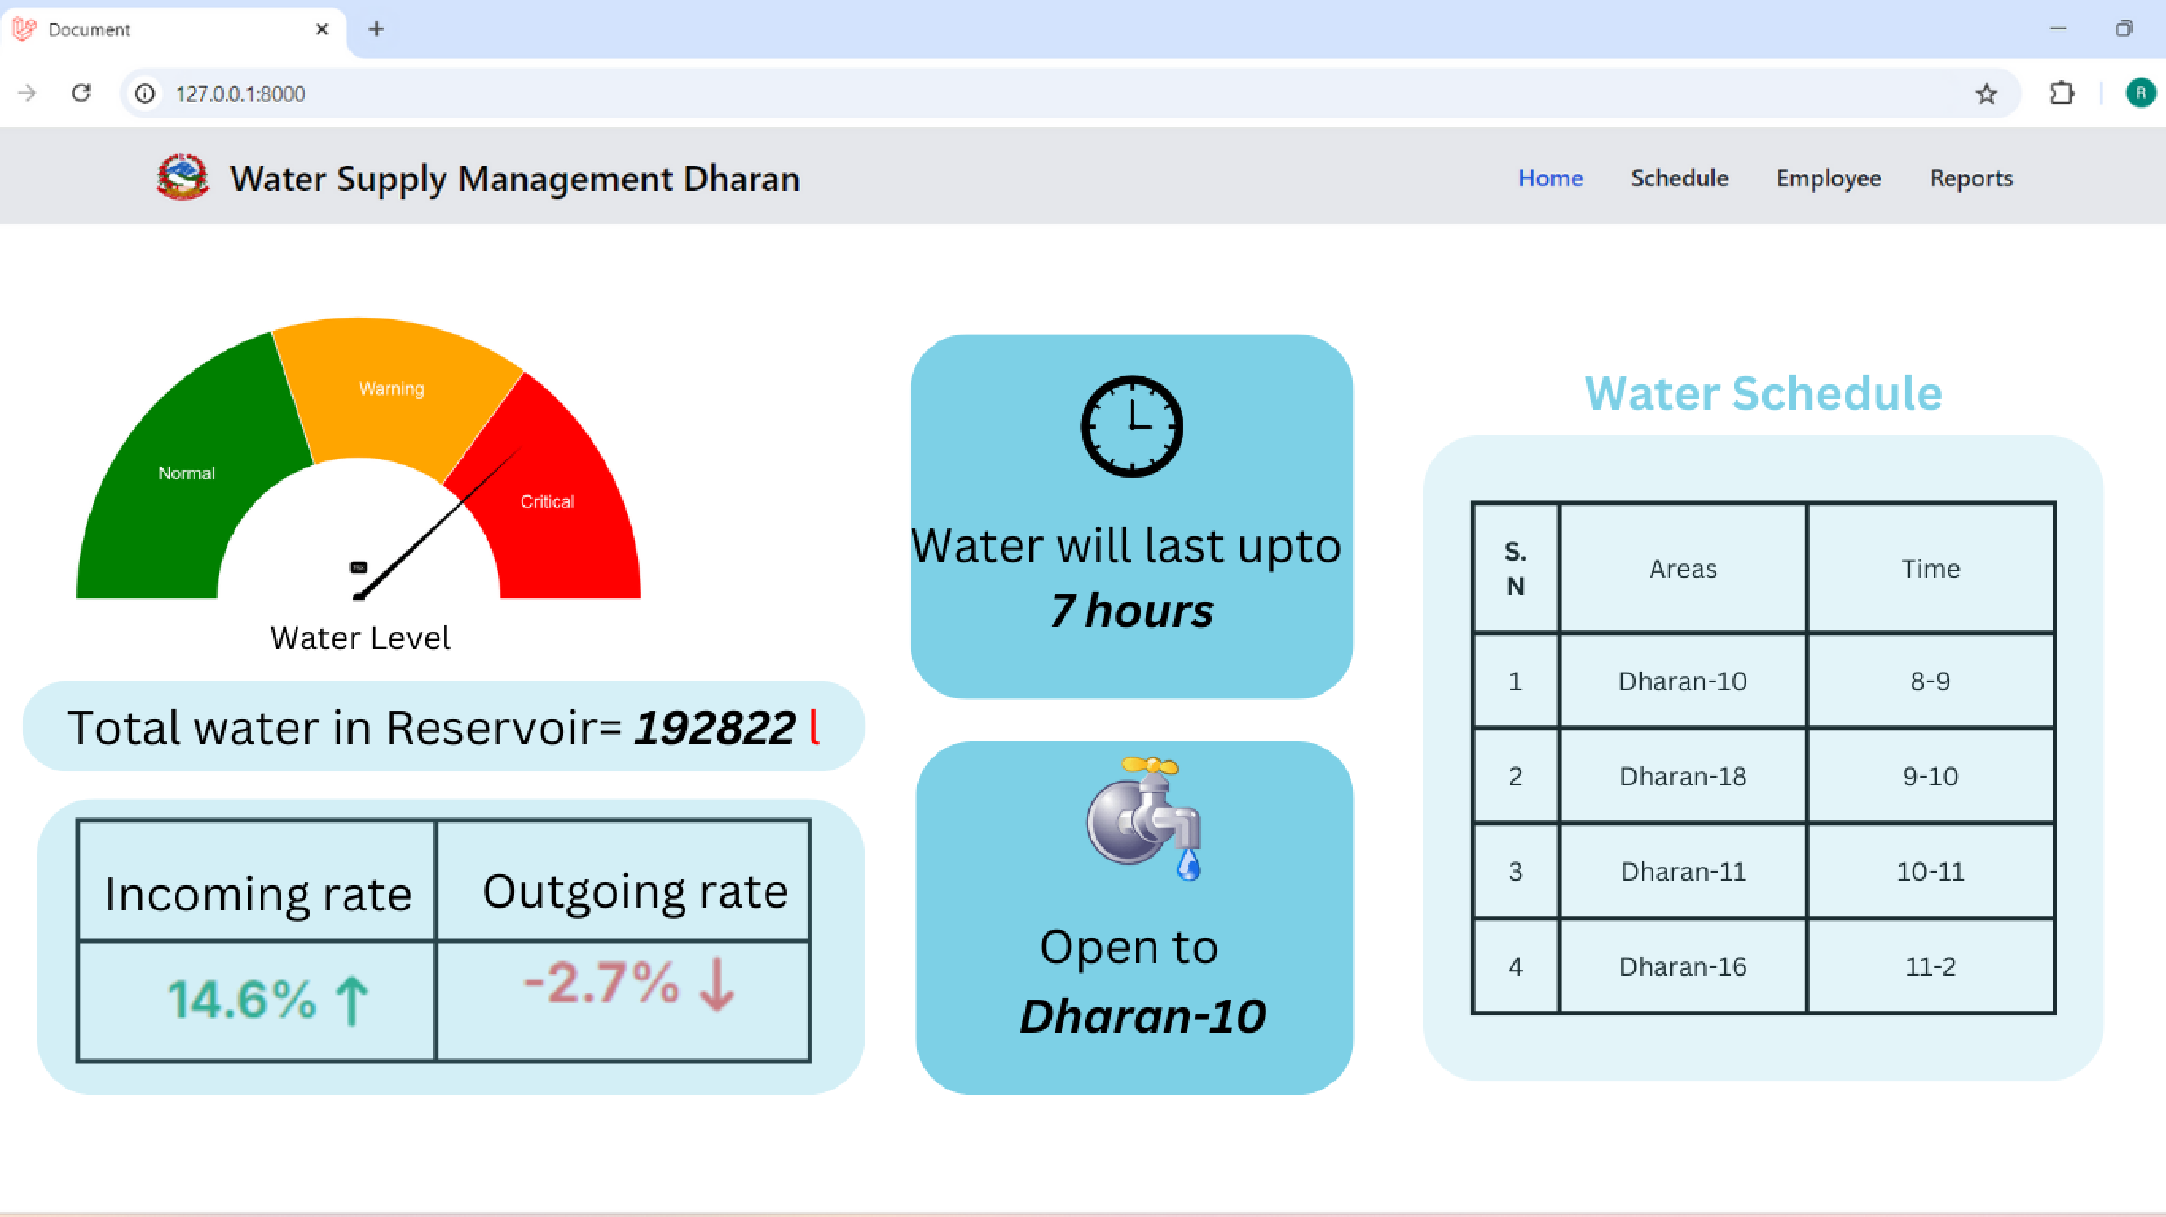

Slide 15
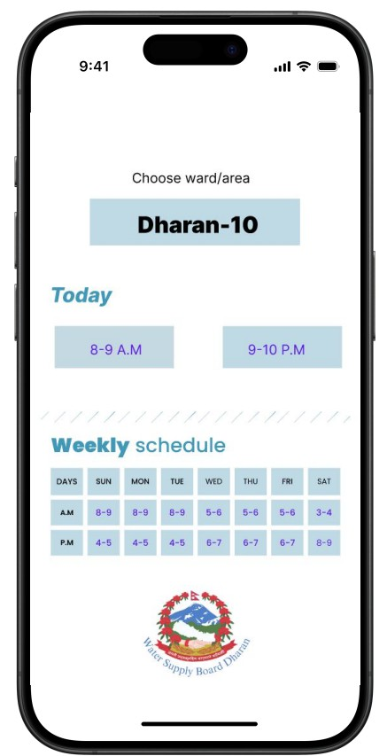

Slide 16
Limitations

Slide 17
Limitations
Absence of IoT Devices, sensors or SCADA Systems
The project does not incorporate Internet of Things (IoT) devices, sensors, Supervisory Control and Data Acquisition (SCADA) systems, or other technological instruments that can measure and transmit real-time water levels.
Dependence on Assumed and Provided Data
The timeframes for water distribution are also determined based on the population and demand assumptions, which may vary from actual consumption patterns and the water distribution logic is based on estimates rather than real-time consumption data.

Slide 18
Do our project actually solve the water crisis ?

Slide 19
Methodology

Slide 20
Methodology
Requirement Identification
Study of Existing System
Sustainable WASH for all Sustainable WASH for all, SUSWA, is a bi-lateral human rights progressive Water, Sanitation and Hygiene project project funded by the Government of Nepal (GoN) and Government of Finland (GoF), as well as the European Union.The project seeks to improve equitable access to safe drinking water, sanitation services, and hygiene practices.
Sensor Dashboard Tank Status Overview SUSWA is implementing sensor dashboards to
enable municipalities to remotely monitor the functionality of water systems and determine the necessary technical or financial support. These sensors, utilizing ultrasonic technology, measure water levels in tanks and transmit data via the local GSM network. At regular intervals, they automatically report the water level in the tanks, which is then displayed live on a web-based interactive dashboard in both volume and percentage. Offers detailed insights, including the number of monitored tanks, their locations, capacities, current water levels, and usage trends.

Slide 21
Requirement Analysis
Functional requirements
Admin Dashboard water level monitoring
incoming and outgoing water flow prediction of how long the water lasts scheduling water timetable
Water timetable for customer
Non functional requirements
User-friendly interface
Reliability

Slide 22
Feasibility Study
Technical
Following technologies have been chosen for the project
Laravel- for the backend development of the system.
MySql- As an Database.
Tailwind- Styling Frontend
Android SDK- For developing the Mobile version of the proposed System.
Github- For version control and managing the application. Vs code- As an IDE(Integrated Development Environment) LaTex- For preparing the documentation and reports

Slide 23
Feasibility Study
Operational
There is no any digital system used by the Water Supply Board of Dharan to technically address the problem. So with the help of this software it will give more ease to the Water Supply Board of Dharan to gather the real time statistics to efficiently distribute the water. Also the people in Dharan can easily use the mobile app for viewing the water schedule.

Slide 24
Feasibility Study
Economic
Since this system will be used by the Water Supply Board of Dharan. By signing the terms with Dharan Sub Metropolitan City , we can handover to them. No major cost has occured since we made it ourselves.

Slide 25
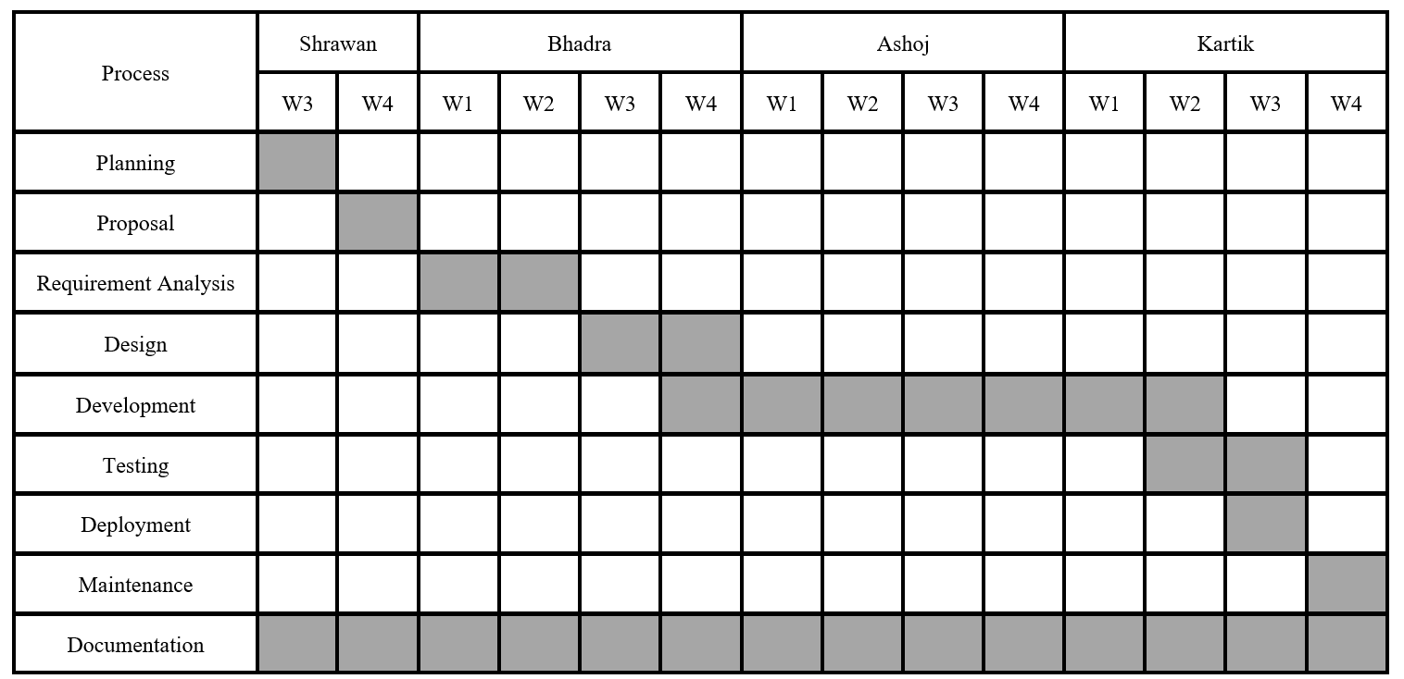
Feasibility Study
Schedule
Project is expected to last for 14 weeks, starting from 3rd week of Shrawan and ending in last of Kartik.

Slide 26
High Level System Design
Design Approach: We will be following Waterfall model - linear sequential approach.
System Architecture
1. Presentation Layer
Admin Panel (Web View) : The admin panel will allow the administrator to monitor and administer the water levels in various tanks, schedule water supply to different areas, and view usage reports.
Mobile App (API Integration):The mobile app will be integrated using RESTful APIs provided by Laravel, allowing users/client to track water supply routines from the system

Slide 27
High Level System Design
System Architecture
2. Business Logic
(a) Controller: water level monitoring controller, water supply/distribution controller
3. Database
(a) Mysql: The relational Database model Mysql has been used for this system to store all the necessary data that the system is intended to use.

Slide 28
High Level System Design
Algorithm
We utilized a priority queue approach in the algorithm, which operates on the First-In-First-Out (FIFO) principle. However, only the areas with higher priority are placed in the queue, ensuring that those with greater need are served first.

Slide 29
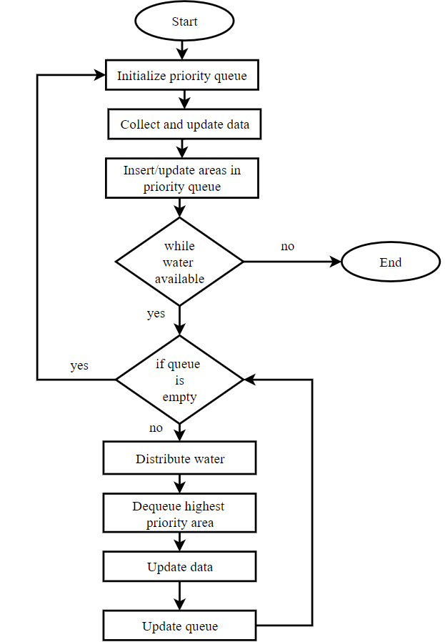
fig) Flowchart

Slide 30
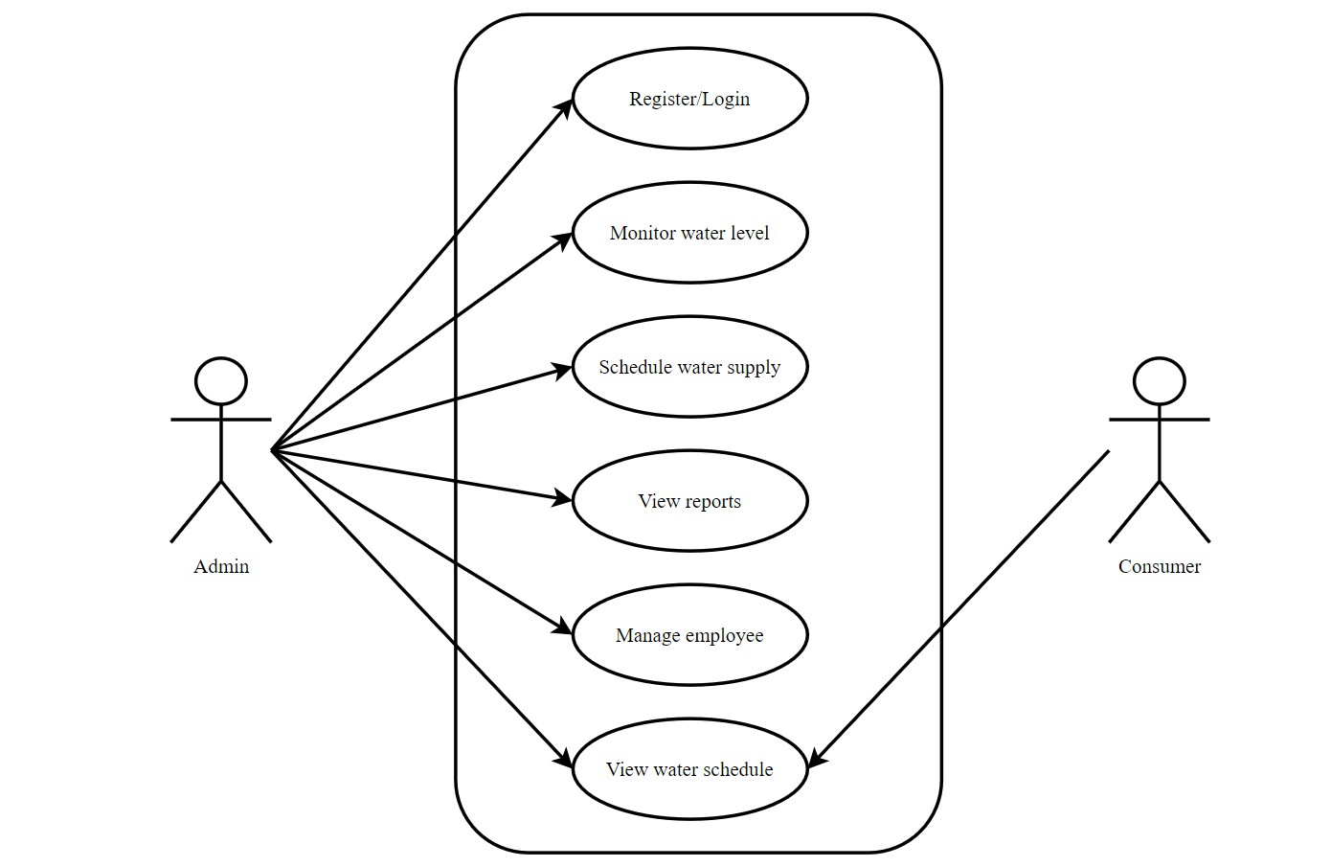
fig) Use case diagram

Slide 31
Expected Outcome

Slide 32
Expected Output
The expected outcome of this research project is the implementation of a system that ensures equitable water distribution based on real-time data, addressing the current disproportionate allocation caused by manual guesswork. By integrating this system, water management authorities will gain insights into both the available water in tanks and the varying demands across different areas, which fluctuate based on factors like population density. This data-driven approach will allow for the fair distribution of limited water resources, mitigating shortages and ensuring that areas with greater need are prioritized while still maintaining equity. Ultimately, the system aims to minimize the deficit until new water sources can be developed.

Slide 33
References

Slide 34
References
[1] Aaron O’Neill. Urban population share in nepal in 2023, 2023. Data retrieved from website preview.
[2] Rajesh Kumar Rai, Kaustuv Raj Neupane, Roshan Man Bajracharya, Ngamindra Dahal, Suchita Shrestha, and Kamal Devkota. Economics of climate adaptive water management practices in nepal. Heliyon, 5(5), 2019.
[3] SUSWA. Suswa - sustainable water and sanitation in nepal. Website, 2024. Accessed: September 8, 2024.
[4] Jangbahadur Prasad Yadav, Krishna Pratap Sah, Kaji Ram Karki, Mukti Nath Jha, AK Mishra, et al. Dharan water supply system–alarming issues and future. J. Adv. Res. Civ. Environ. Eng, 10:1–11, 2023

Slide 35
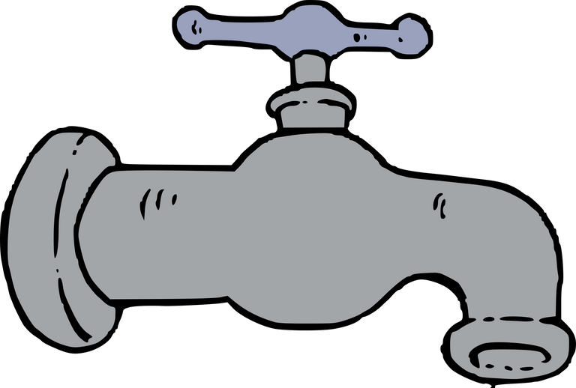


Thank you

Slide 36
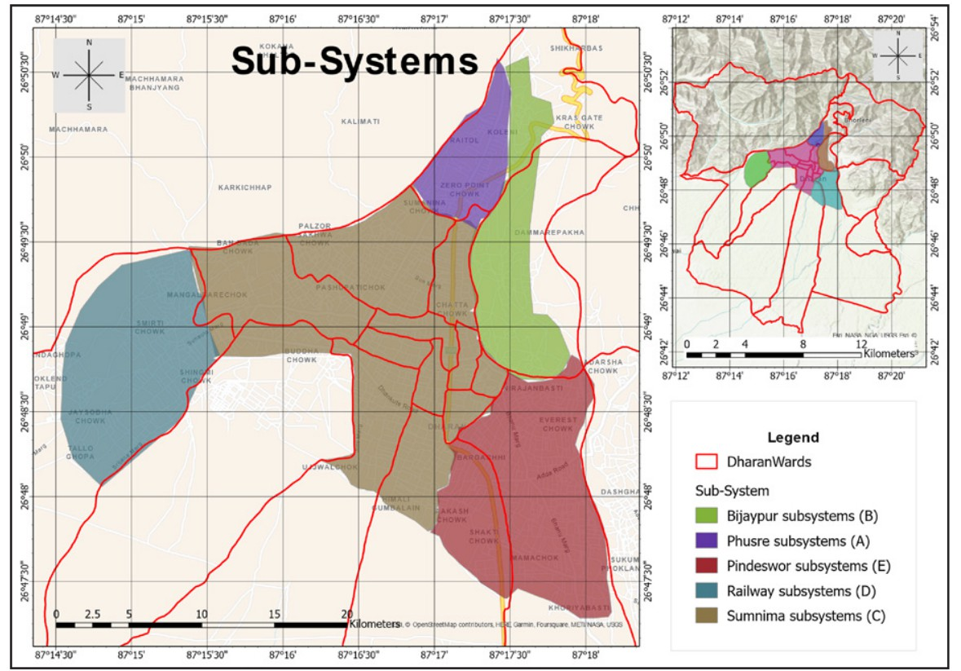

Slide 37
Zone | Area (Ha) | H.H (no) | Ward Coverage | Ward Coverage | Reservoir Size (Cu.m)
Zone | Area (Ha) | H.H (no) | Full | Partial | Reservoir Size (Cu.m)
A | 114.4 | 2224 | - | 1,4,13,16 | 500
B | 220.2 | 2640 | 14 | 3,7,13,15 | 600
C | 584.29 | 13481 | 2,4,5,6,9,10,12, 18,19 | 1,3,4,7,8,11, 15,16,17 | 3000
D | 296.998 | 3349 | - | 11,17 | 500
E | 351.5 | 7147 | 15 | 7,8,15 | 1600
Ha = Hector square Cu.m = Cubic metre
H.H = households

Slide 38
1 Cu.m = 1,000 litres
Zone | Area (Ha) | H.H (no) | Ward Coverage | Ward Coverage | Reservoir Size (Cu.m)
Zone | Area (Ha) | H.H (no) | Full | Partial | Reservoir Size (Cu.m)
C | 584.29 | 13481 | 2,4,5,6,9,10,12, 18,19 | 1,3,4,7,8,11, 15,16,17 | 3000
3,000 Cu.m = 3,000,000 litres ie 3MLD

Slide 39
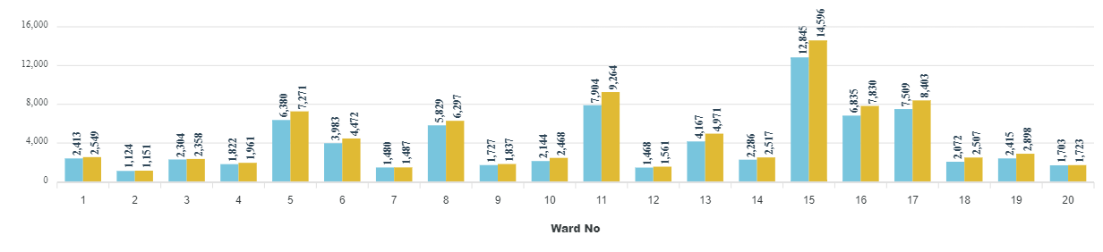

Slide 40
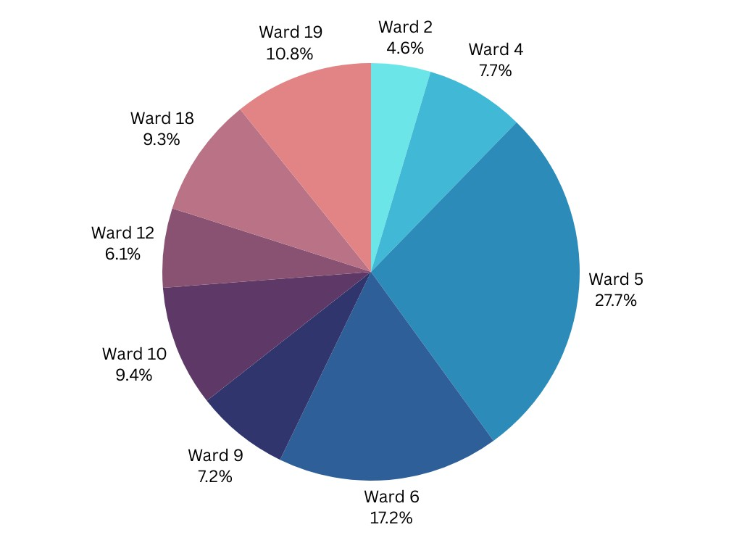
fig) No of households in Subsection-C

Slide 41
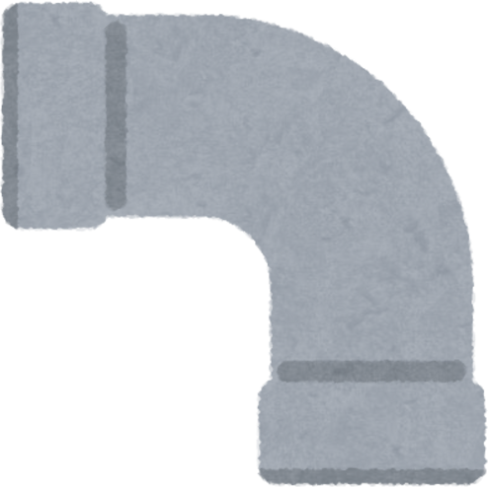
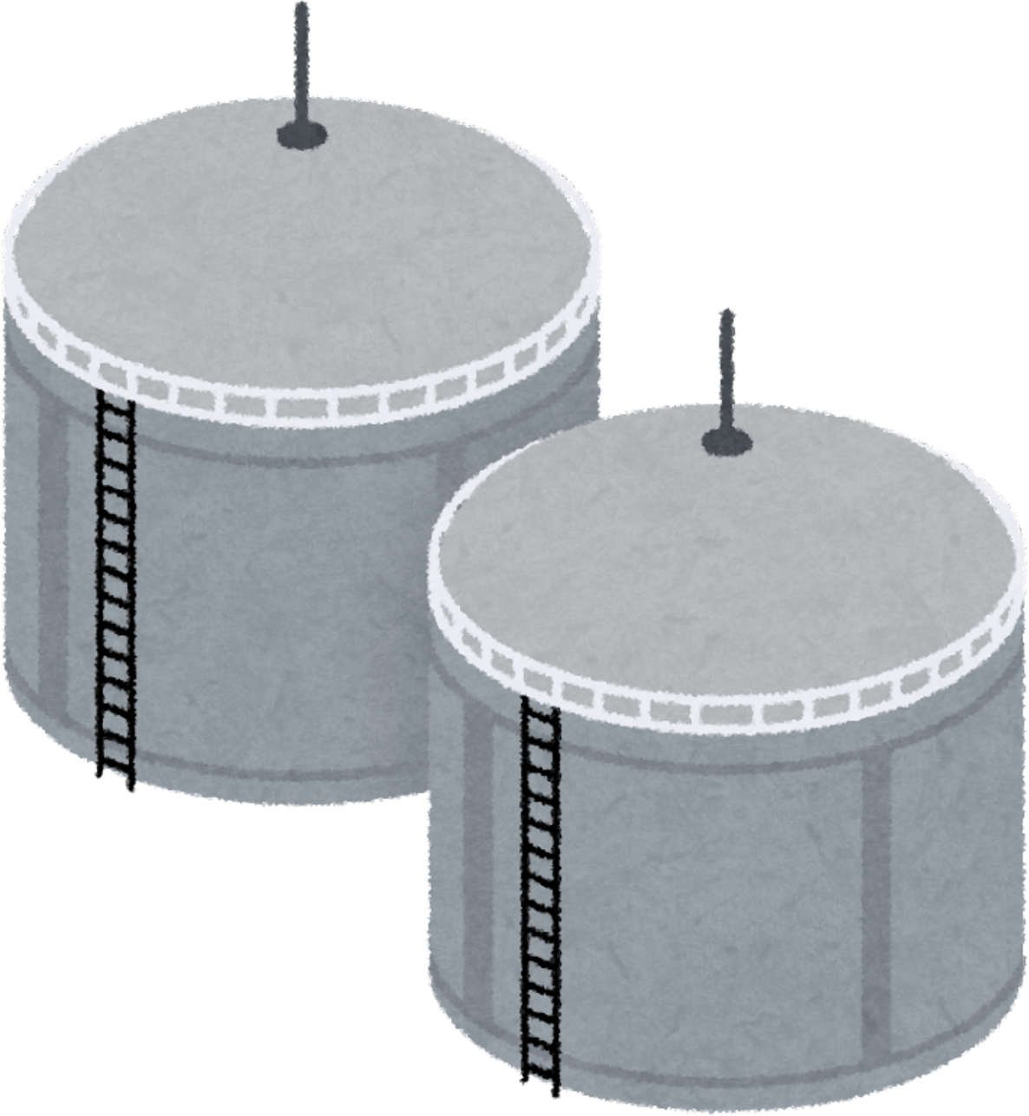
Incoming rate
+
Water Level = water in tank + Incoming rate
-
Outgoing rate
These rates will be manaul data as we dont have IoT
Outgoing rate
-

Slide 42
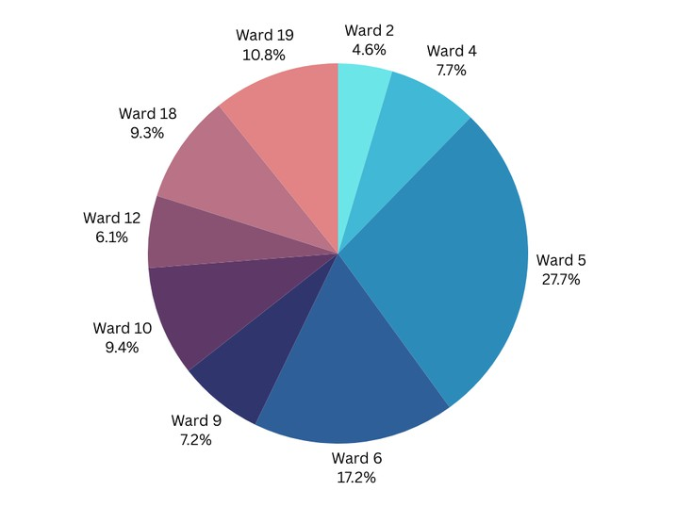
Time frame for water supply for different wards will be different because they have different
no of houses (houses density)
Time will be allocated according to houses density

